Slide 1
Predicting Credit Card Customer Segmentation
SUBMITTED BY: GUIDED BY:
Anjali Dembla (ad1704) Dr. Shahrzad Haddadan Daniel Tamayo(dat135) Mariya Ghori (mag494) Sowmya Yalamanchili (sy744) Tejesh Alaparthi (ta560)

Slide 2
Introduction
About Dataset:-
The dataset given can be used to analyze the key factors that influence customer attrition.It can be used to understand customer demographics, spending patterns, and relationship with the credit card provider to better predict customer attrition
Problem Statement Given:-
Use two classification methods for the classification of Churned and Existing Customers
Compare the two models

Slide 3
Agenda
Graphs and Insights From Initial Study of Data
Data Preprocessing Steps
Model 1
Model 2
Conclusion
Answers to Group Assignment

Slide 4
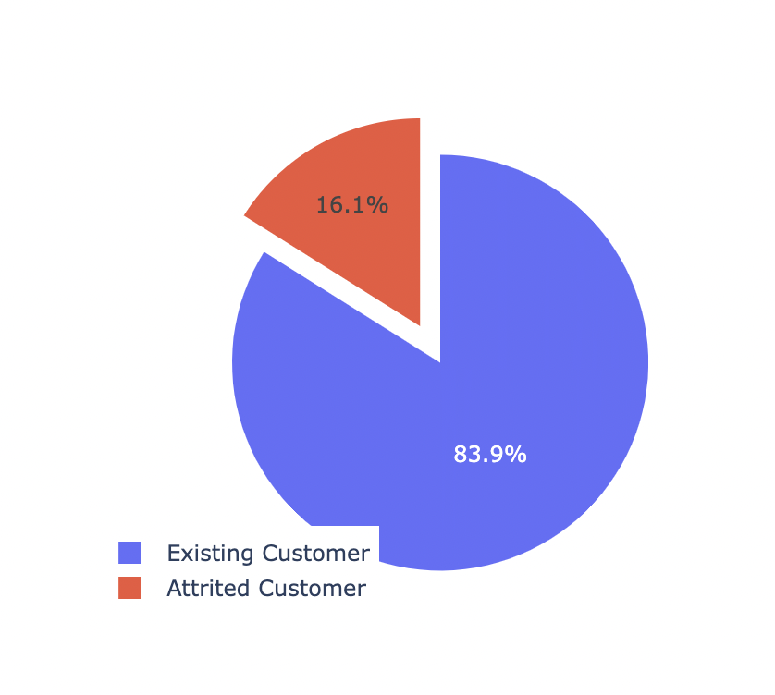
Distribution of Attrition Rates

Slide 5
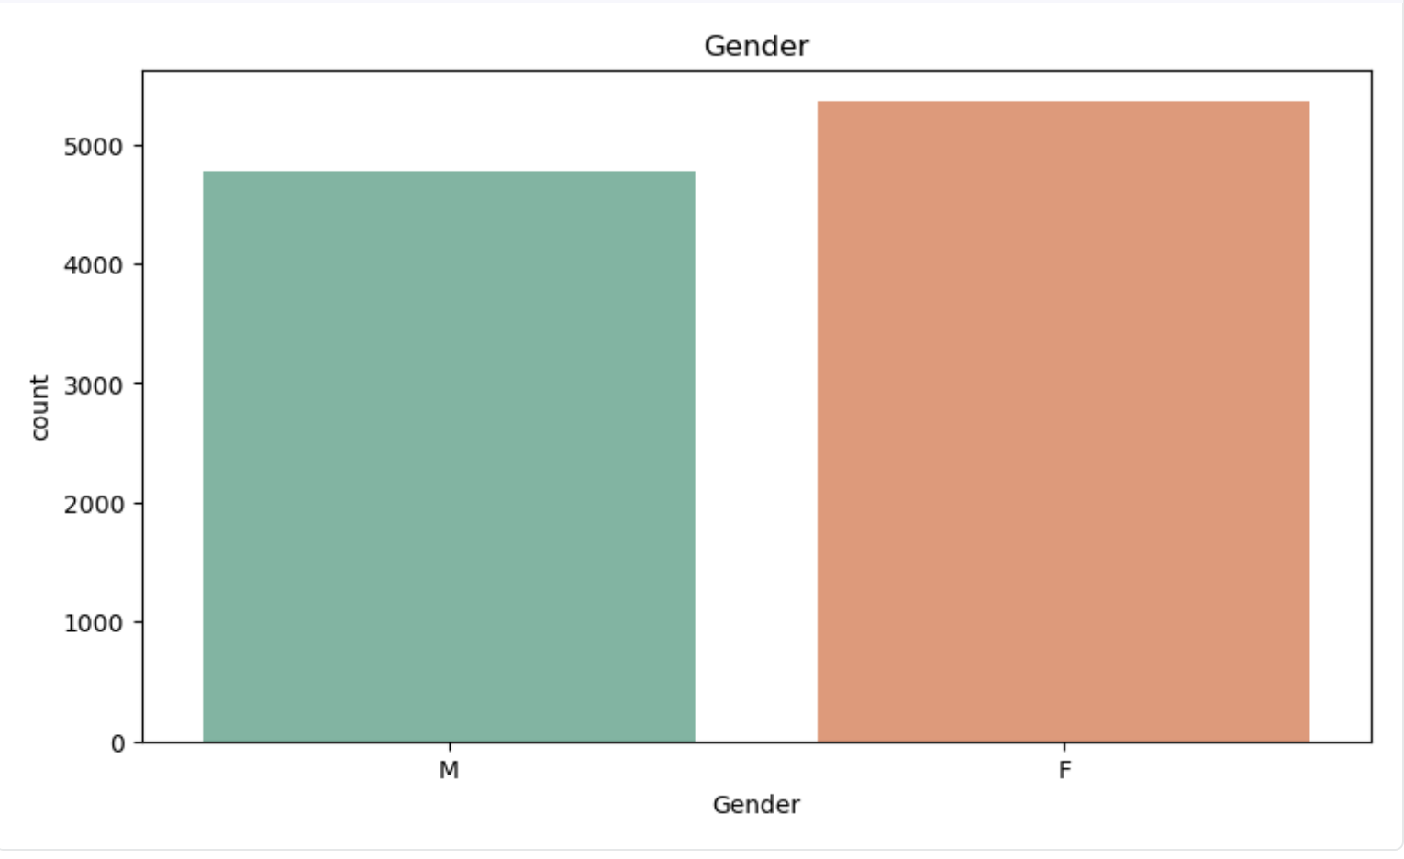
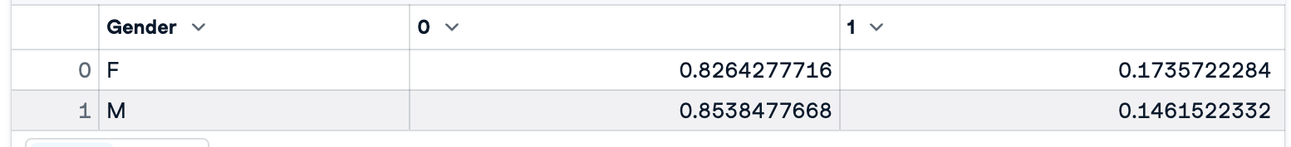
Initial Graphs and Insights - Distribution of Gender

Slide 6
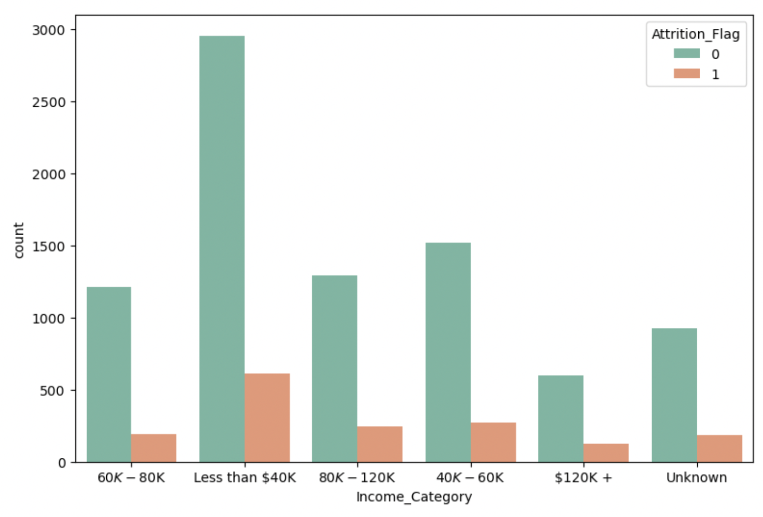
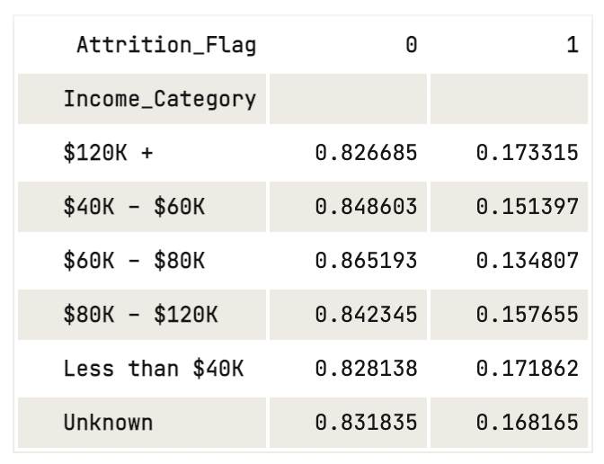
Distribution of Income

Slide 7
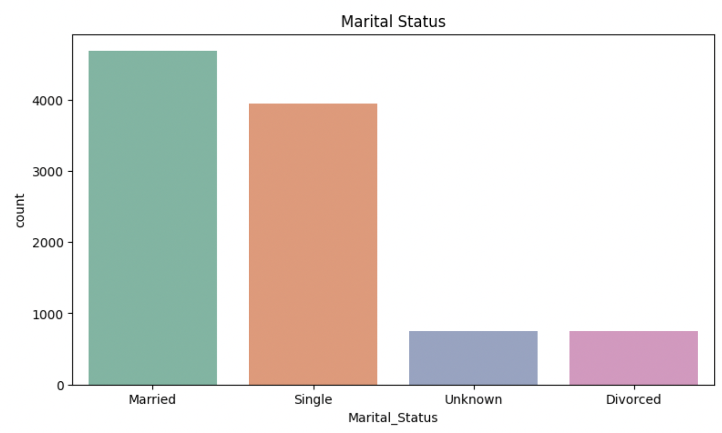
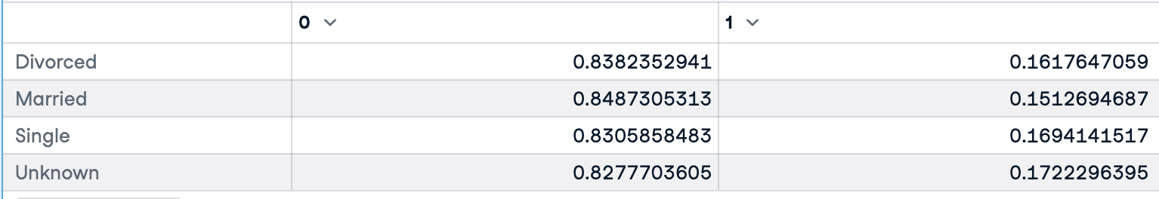
Distribution of Marital Status

Slide 8
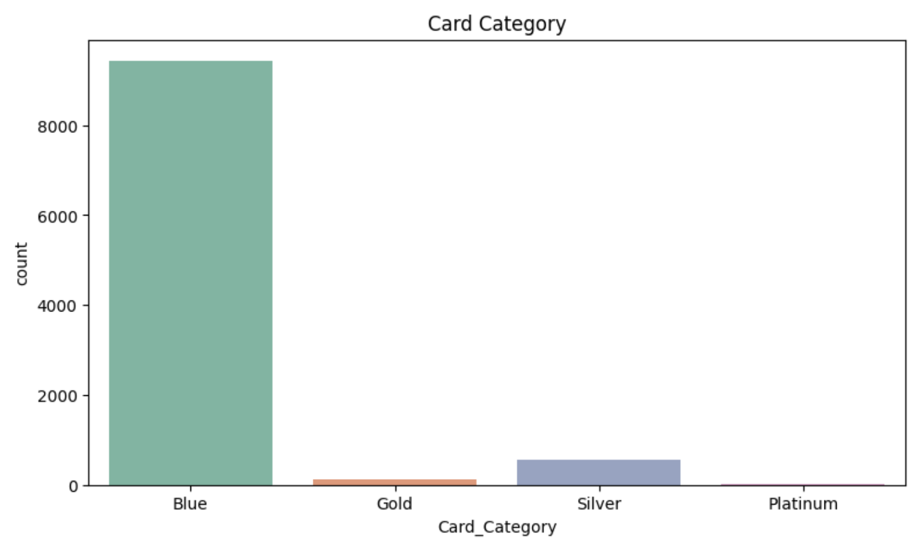
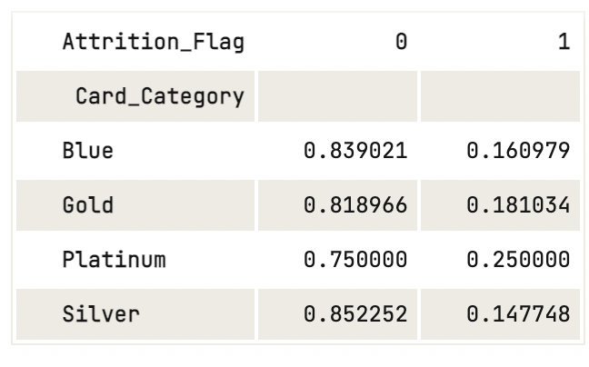
Distribution of Card Category

Slide 9
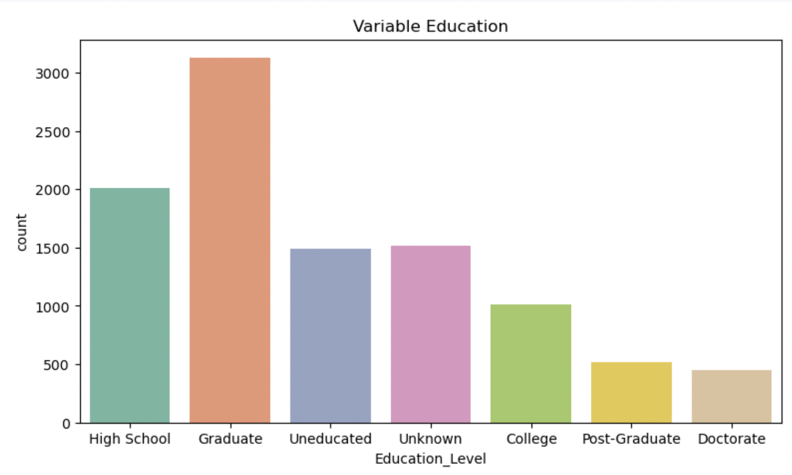
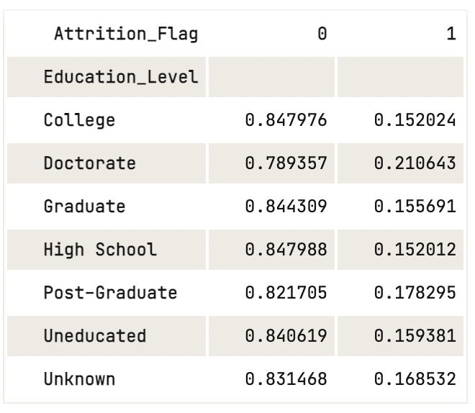
Distribution of Education

Slide 10
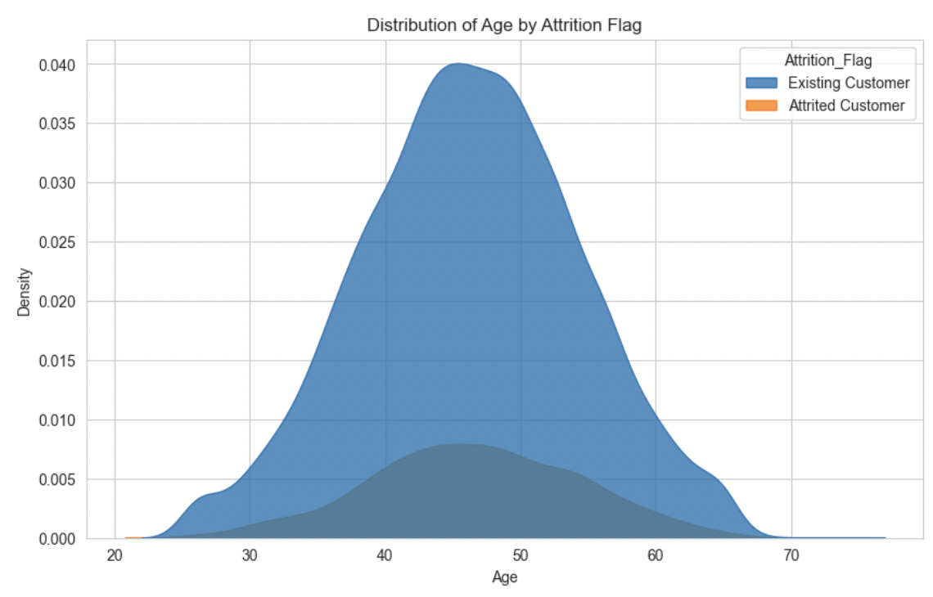
Distribution of Age by Attrition

Slide 11
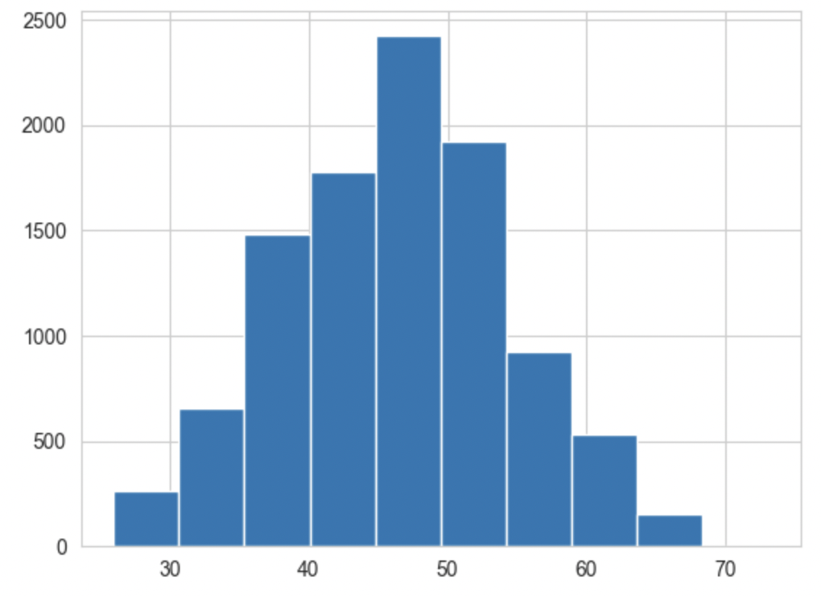
Distribution of Age

Slide 12
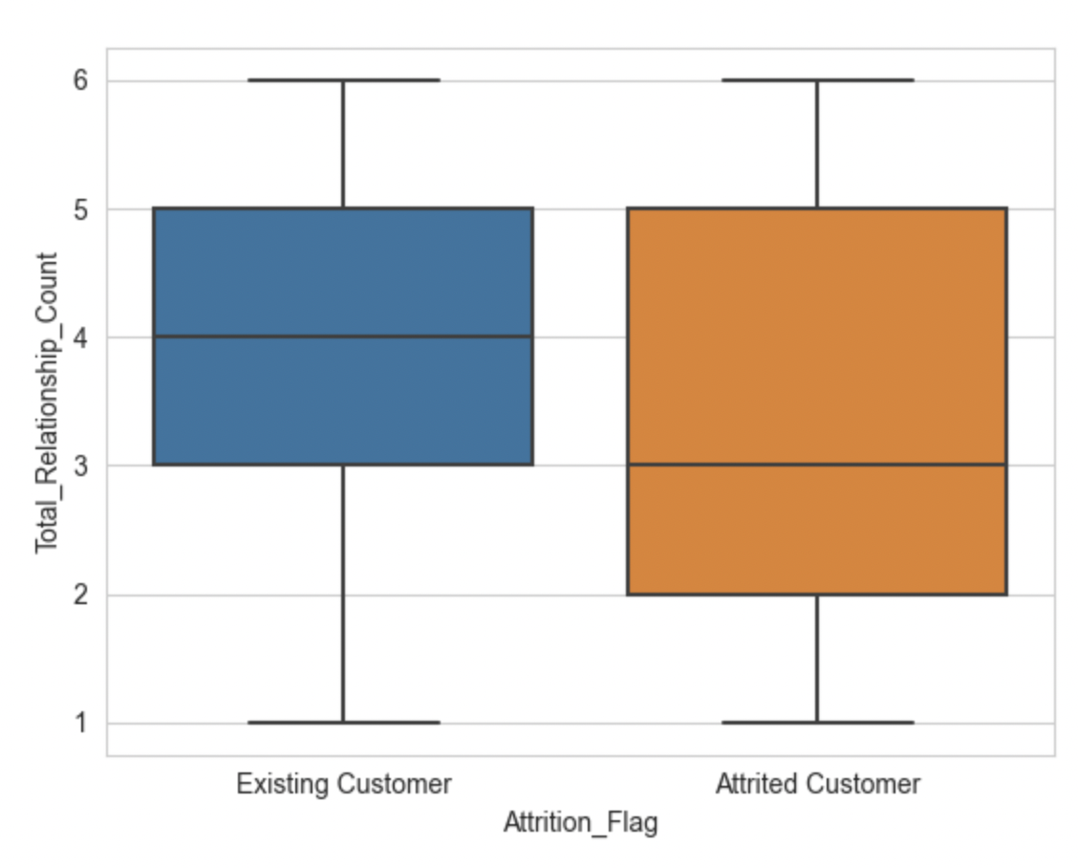
Comparing Attrition with Total Relationship Count

Slide 13
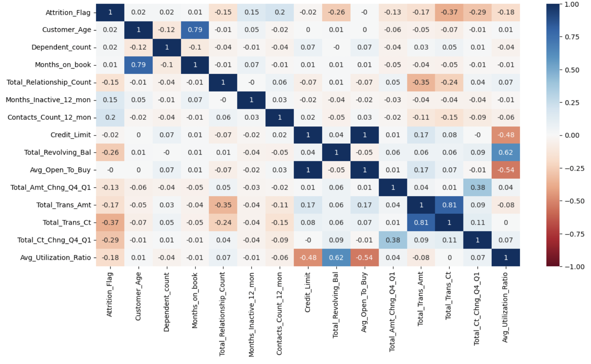
Correlation Matrix

Slide 14
Data Preprocessing
Check for duplicates revealed none
Check for nulls - there were none
Drop unnecessary columns - Naive Bayes classifiers, Client Number
“Unknown” was present in Education_Level, Marital_Status, Income_Category
We removed the “unknowns”
Created dummy variables for Education_Level, Marital_Status, and Income_Category
Transformed Gender attribute into a binary variable- Male = 0, Female = 1
Standardized numerical columns using StandardScaler

Slide 15
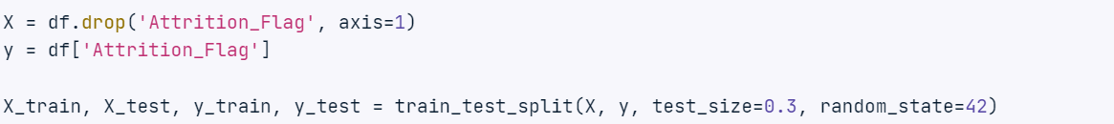
Modeling
Separate the features (independent variables) from the target variable (dependent variable) in a dataset.
Since Attrition_Flag is the target variable, take it into separate dataframe.
Split the data into training and test sets. 30% of the data will be used for testing and remaining 70% will be used for training.

Slide 16
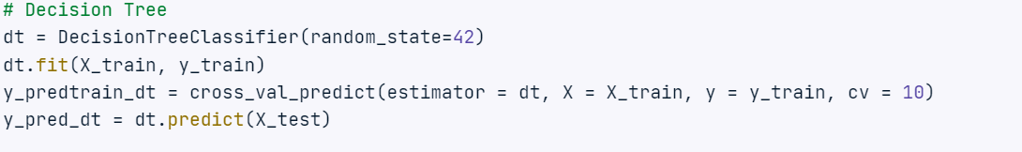
Decision Tree Classification

Slide 17
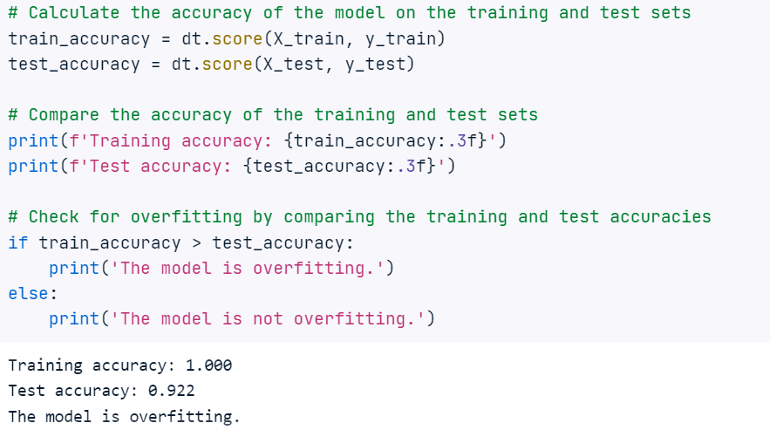
Since decision trees are prone to overfitting, find out if the model we built is overfitting.

Slide 18
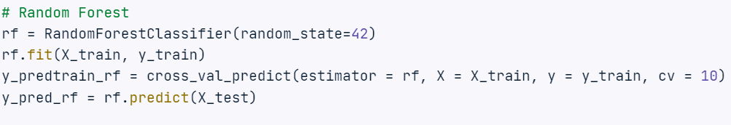
Random Forest
To improve performance and reduce overfitting, let’s build a random forest classification model

Slide 19
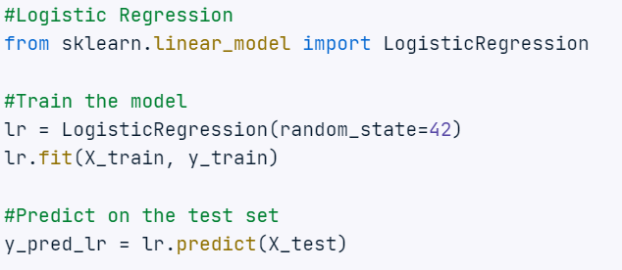
Logistic Regression

Slide 20
Evaluation of Models
Once the model is trained and tuned, evaluate its performance on the test set to understand how well it performs on the new data.
Use cross-validation to predict the class labels of the training data.
Calculate the accuracy_score for the target variable using test set data.
Generate a classification_report for y_train and class labels predicted using cross-validation for validation purpose.
Generate a classification_report for y_test and class labels predicted using test set for evaluation purpose.
Compare the values of accuracy, F1-score(if precision and recall are considered for evaluation metrics) and choose the best model.

Slide 21
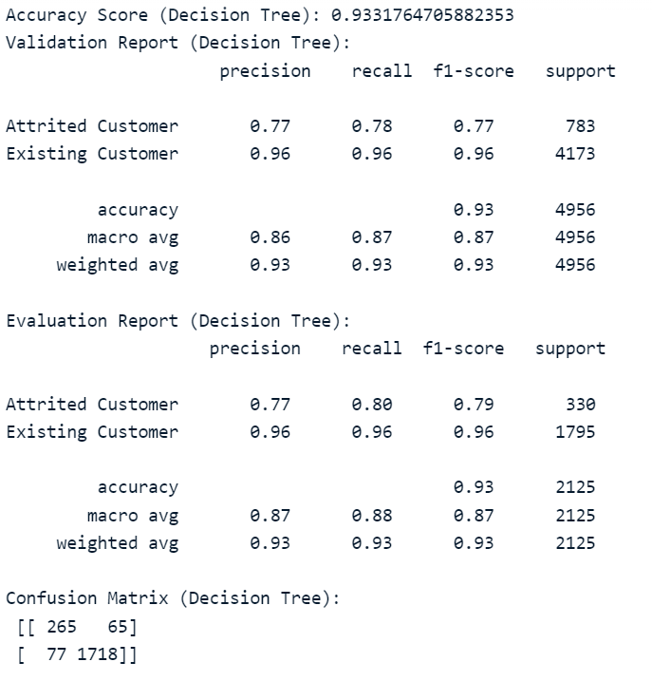
Evaluation of Decision tree

Slide 22
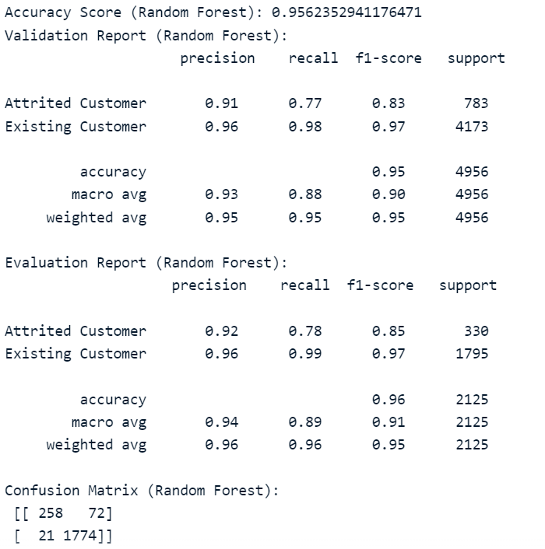
Evaluation of Random Forest

Slide 23
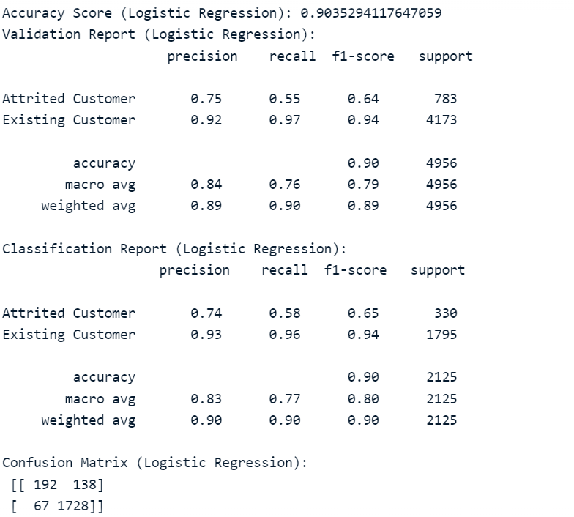
Evaluation of Logistic Regression

Slide 24
Assignment Questions - Review #1
We decided to drop the Client_Num column since it serves of no use when we are running our model and we can gain no insight from it
We decided to get rid of unknown values for Education_level, Marital_Satus and Income_Category since again having unknown values will not be beneficial
We decided to replace categorical variables Male and Female to 0 and 1 since we need this for the model and categorical values can’t be used
We needed to normalize our variables including credit limit, dependent count, etc. This is beneficial so the values have a mean of zero and they have a normal distribution

Slide 25
Assignment Questions - Review #2
We decided on the classification methods=
Logistic Regression
Decision Tree
Random Forest
These were chosen because we felt that these were the best at predicting in the case of binary classification

Slide 26
Assignment Questions - Review #3
We decided to evaluate the models based on F1 score and accuracy. In the end, F1 score is an overall better metric since there are many more existing customers than churned customers in the dataset(around 80 percent)
We decided to choose 30 percent as the case for our test set
We did end up using cross validation - In this case we used 10- folds

